Slide 1


dashup Final Presentation
Team dashup, SAP
18. June 2019

Slide 2

Business Needs

Slide 3

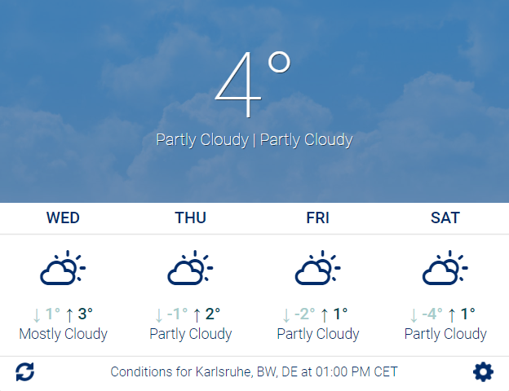
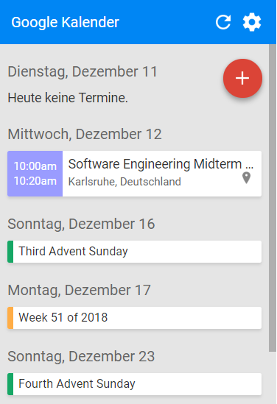
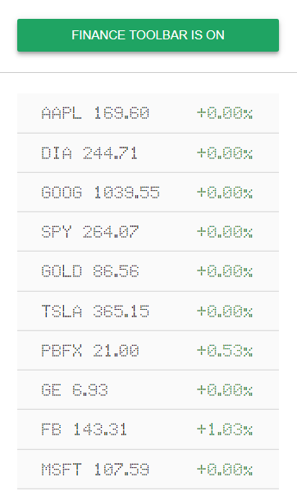
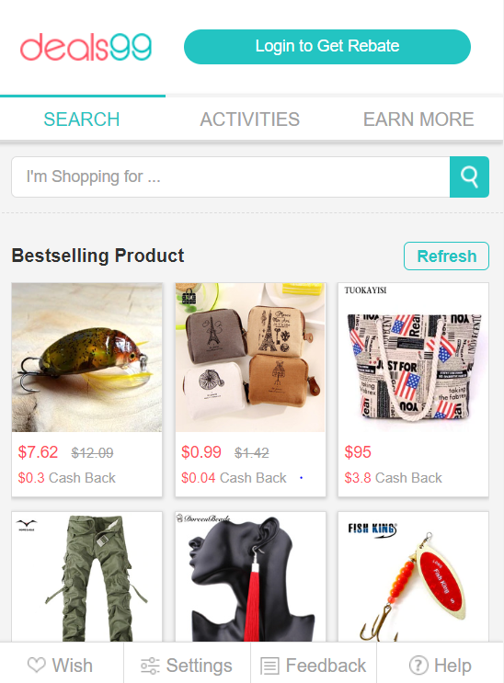

Slide 4


dashup – your productivity tool

Slide 5
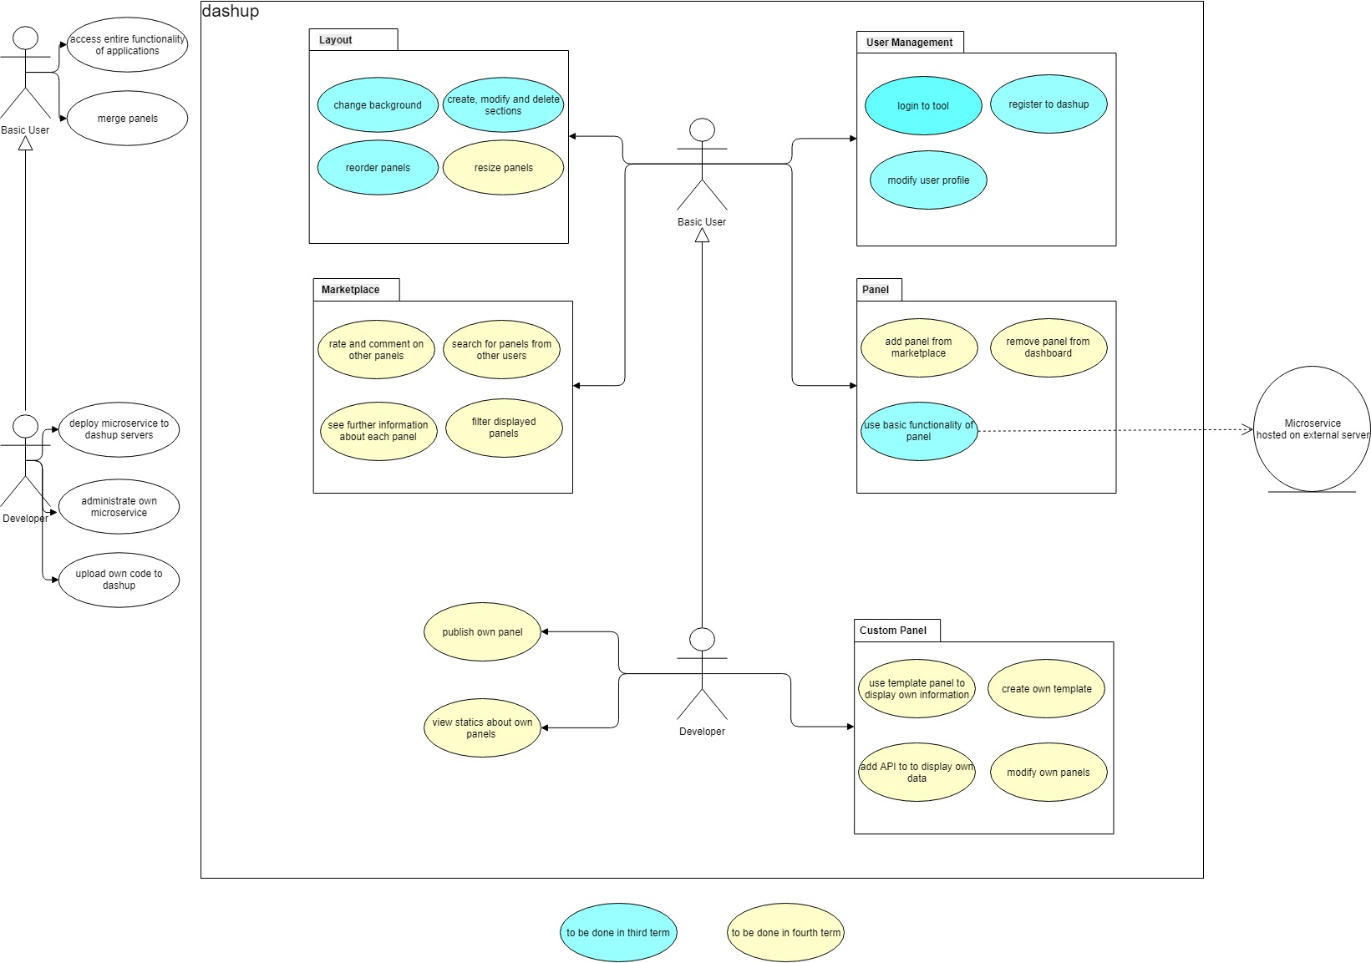

Slide 6

dashup Web Application

Slide 7
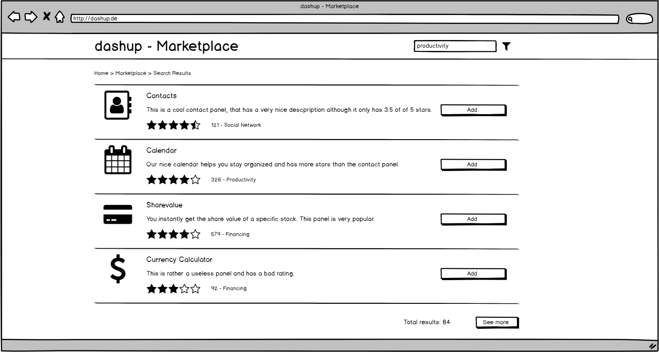
Marketplace

Slide 8
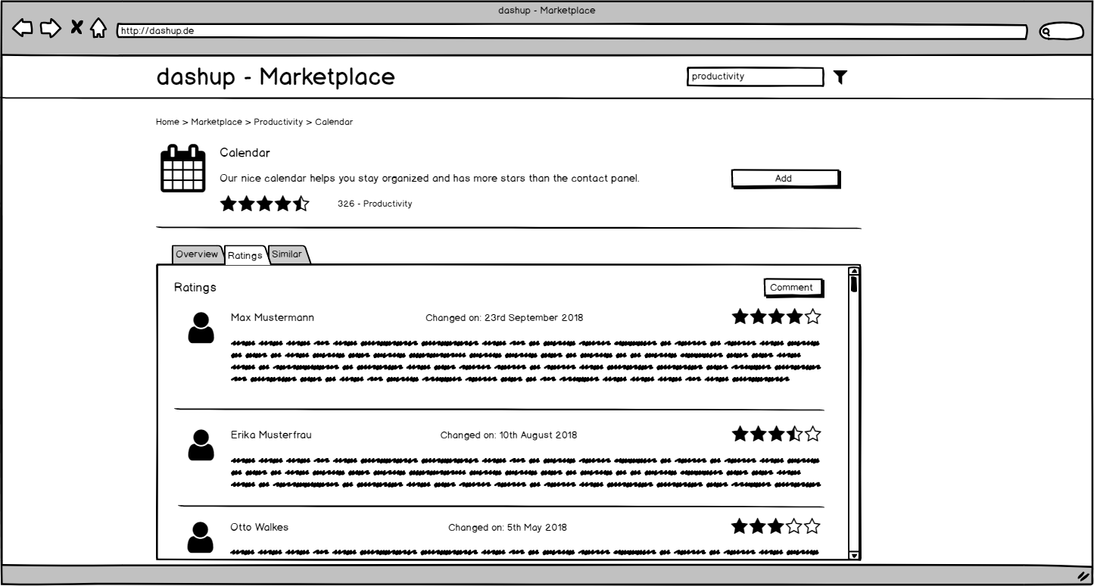
Marketplace

Slide 9

Architecture

Slide 10
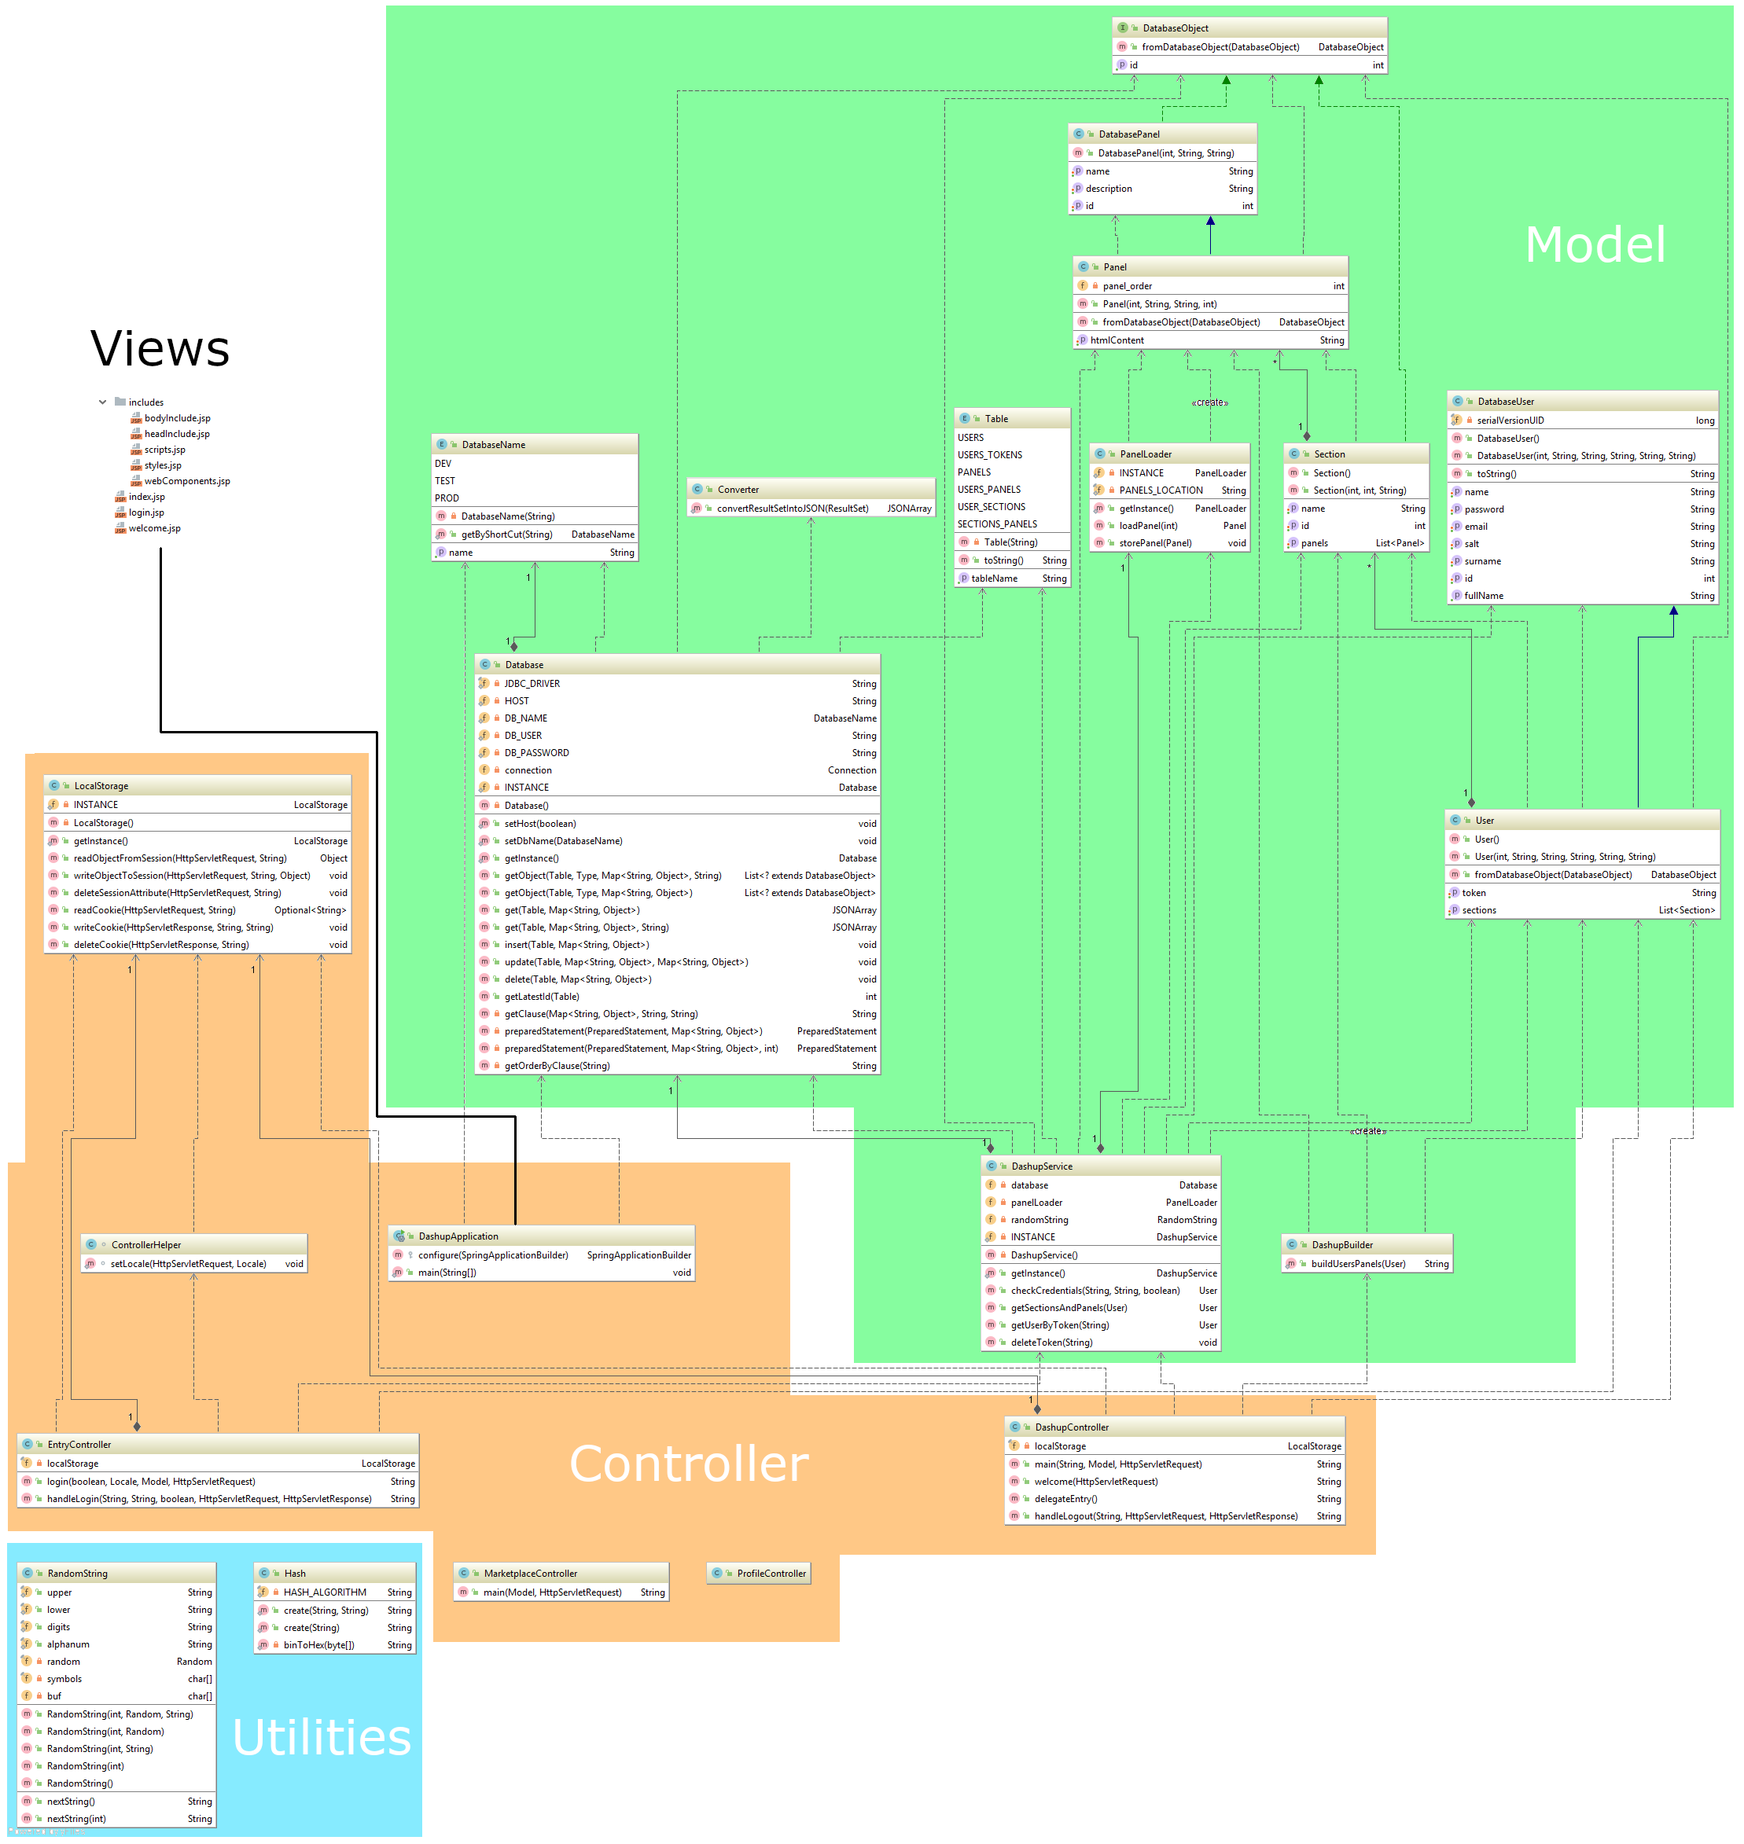
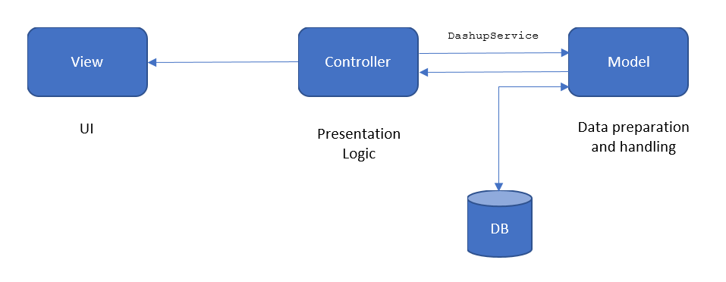
Architecture Architecture
Database
Spring
MVC Structure
Organized in Maven Modules
DashupService
Notes:
Spring:
MVC Structure:
Model View Controller
Seperated by Modules
Maven:
Vorteil: lifecycles
Prädestiniert für Java (Menge an libraries)

Slide 11
Architecture Configuration
Starting Spring application via Maven Plugin
Deployed on VServer (http://dashup.de, Login: http://dashup.de/entry/login)
Using nginx with revers proxy
Notes:
- No Tomcat server

Slide 12
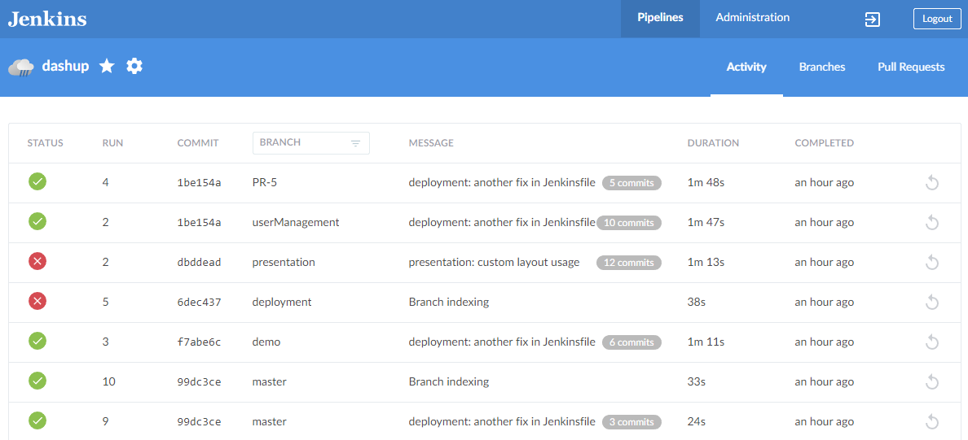
Architecture Automation
Using Jenkins Multibranch Pipeline (https://jenkins.raphael-muesseler.de/)
Notes:
- No Tomcat server

Slide 13
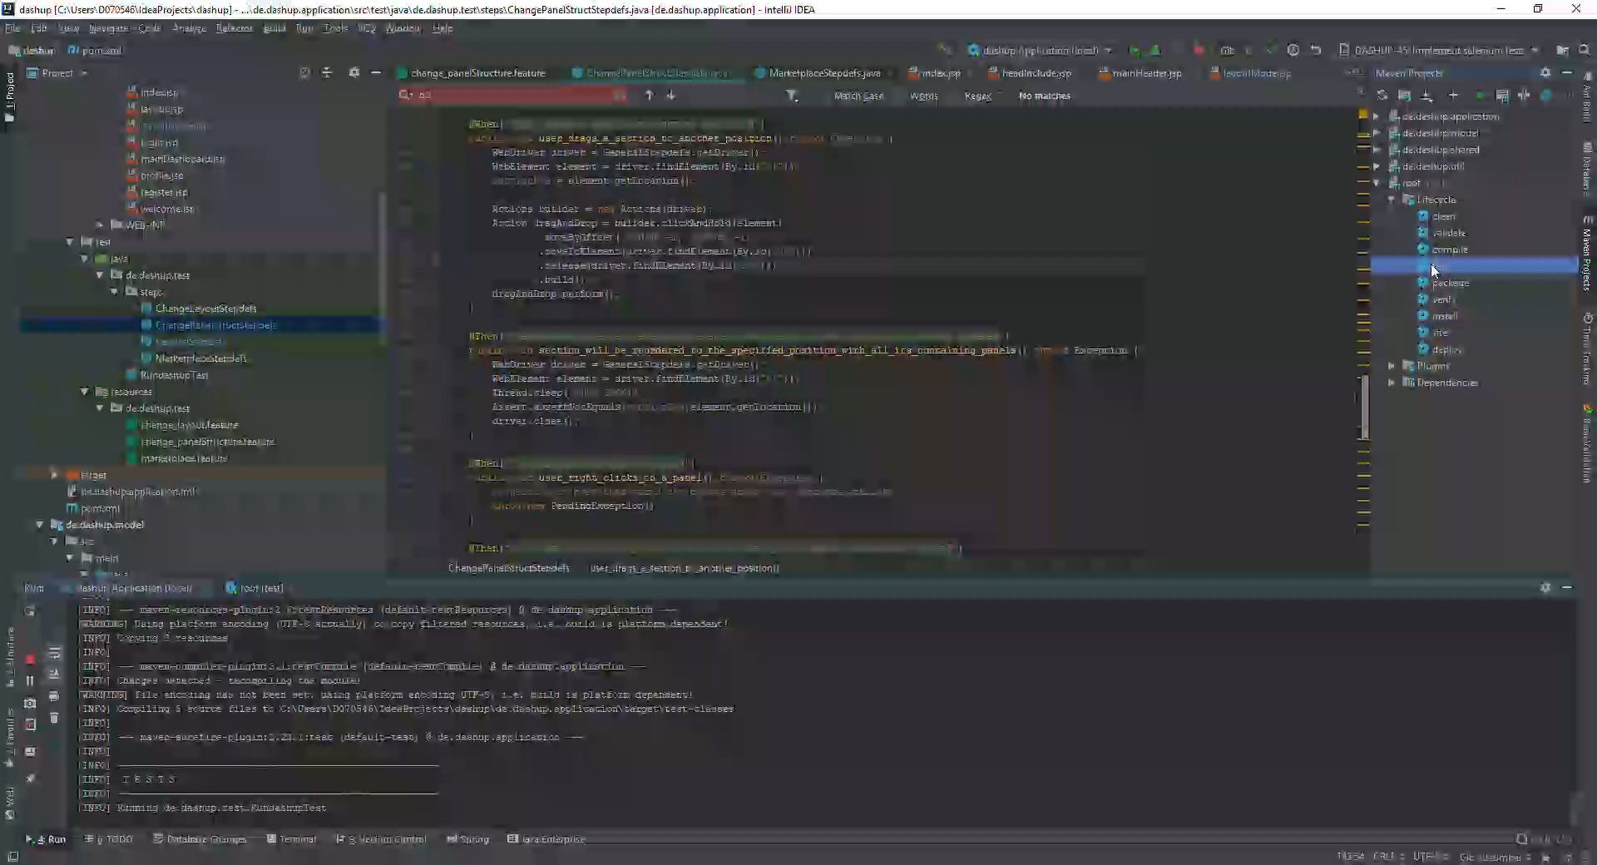
Architecture Testing

Slide 14
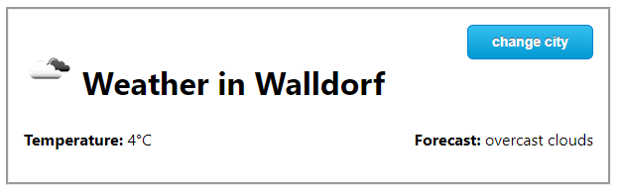
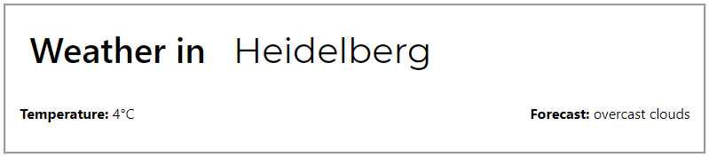
Architecture Creating own custom panels?
<dashup-weather city="Walldorf"></dashup-weather>
<dashup-input name="weatherInput" action="data" api="http://api.openweathermap.org/data/2.5/weather?units=metric&appid=[...] " param="q" consumers="temperature description“/>
<dashup-display name="temperature" />

Slide 15

Project Management

Slide 16

Project Management
Rational Unified Process
Weekly Meetings
Continuous Reviews
Iterative Process
Compliance With Specification
Adapting Requirements Agile
Feature Requests
Open Code
Tool: YouTrack

Slide 17
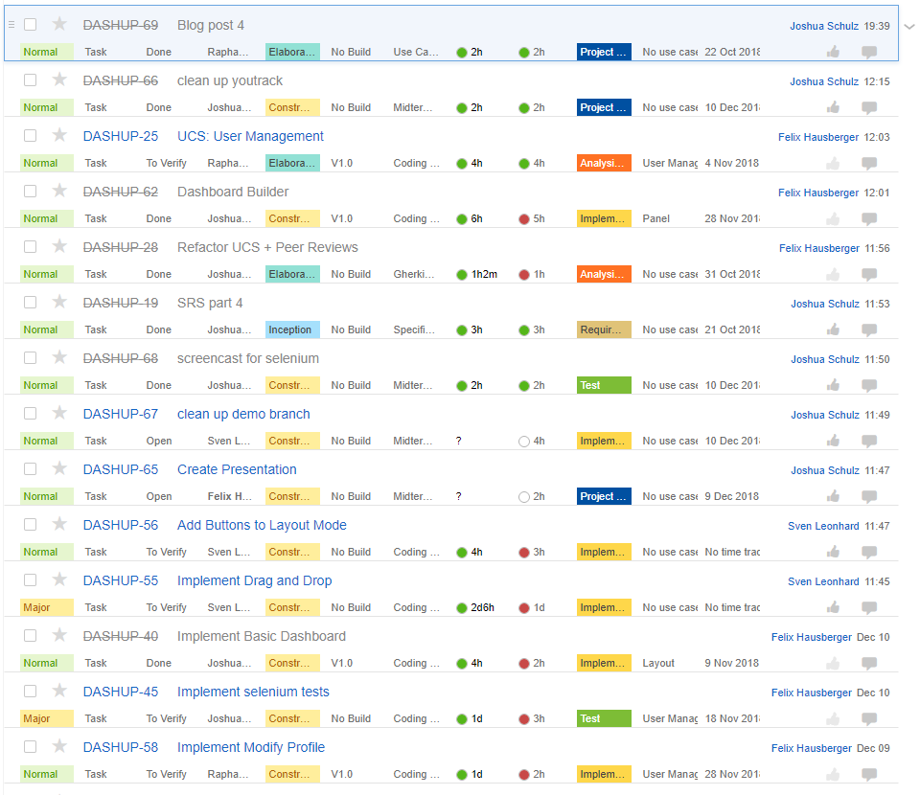
Issues List

Slide 18
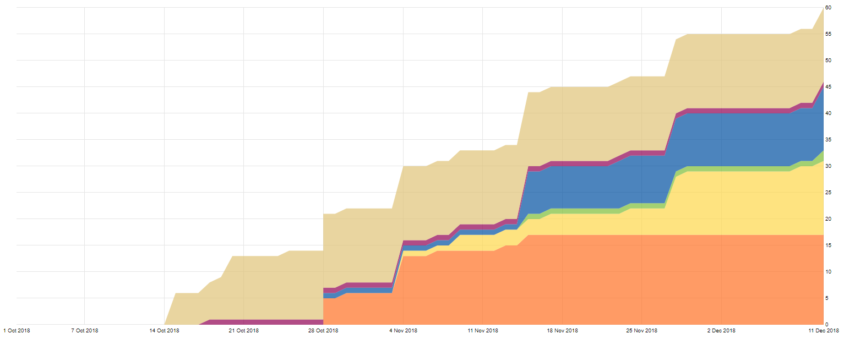
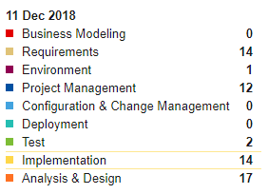
Cumulative Flow

Slide 19
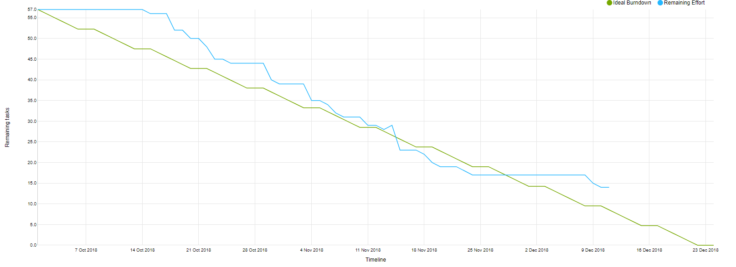
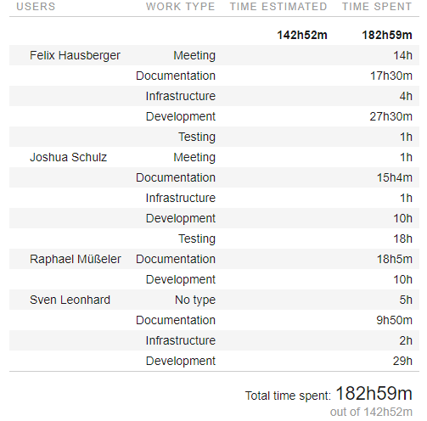
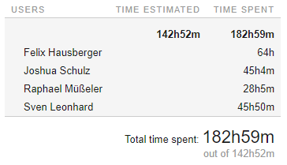
Burndown Chart

Slide 20
Thank You.
Contact Information
Felix Hausberger
Customer Service
Felix.Hausberger@sap.com
0151/51377589
Blog:
https://dashup2k18.wordpress.com/

Slide 22
Template 1
[Text]
[Text]
[Text]

Slide 23
Template 2

Slide 24
Template 3
Ebene 1
Ebene 2
Ebene 3
Ebene 4
Ebene 5

